Slide 1
Applied Data Science Machine Learning in Python
Dr. Omri Allouche
2017

Slide 2
Prerequisites
Read https://www.analyticsvidhya.com/blog/2015/09/naive-bayes-explained/
or http://guidetodatamining.com/assets/guideChapters/DataMining-ch6.pdf (longer)

Slide 3
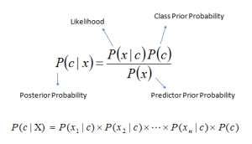
Bayes Formula

Slide 4
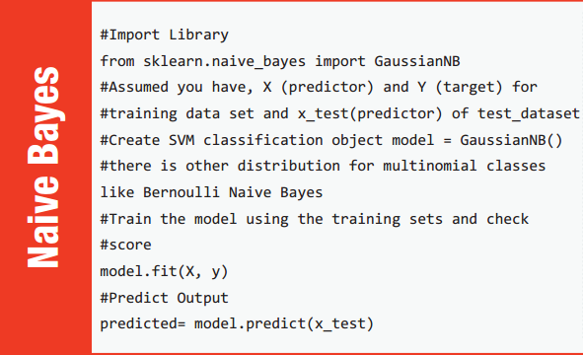

Slide 5
Numeric FEATURES - Distributions
Gaussian
Used in classification. Assumes that features follow a normal distribution
Multinomial
Used for discrete counts (e.g. word occurrences in document)
Bernoulli
Treats feature as binary (e.g. word appears or not in document)
Exponential
Your own

Slide 6
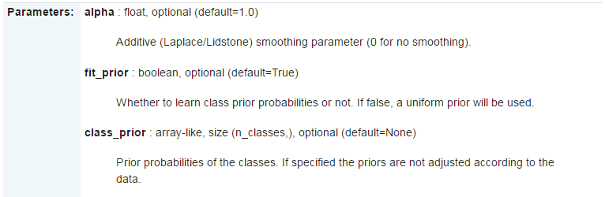
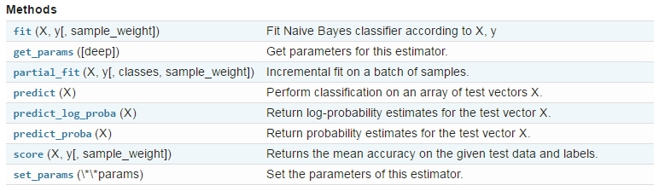

Slide 7
Properties
Very fast
Good for big data with big velocity
Small dataset leads to instability (probabilities can be 0 or 1 with high variance)
Ignores interactions and therefore needs less data
Works well with multiclass problems
Works well with missing data
Continuous features require binning or assumption of a distribution
Doesn’t perform well for imbalanced datasets
Can be used for segments of the data (with other models for the rest)
Can be used as a generative model (e.g. generate text)

Slide 8

Issues
Works better for categorical features. For numerical features, assumes a distribution (often Gaussian distribution)
Instead of multiplication of probabilities, use sum of logs to avoid underflow
Performance degrade with highly correlated features
“Zero frequency” - how to handle values with 0 occurrences?
Often: Use Laplace correction
Known to be a good classifier, bad estimator

Slide 9
Application – Language Model
How likely is each sentence in the language?

